Slide 1
Index
Tutorials:
https://www.youtube.com/live/59id0mDKlbE
https://youtu.be/Zxyy-kThLWE?si=fc4HhKGTgFPv_TtX
Documentation:
https://docs.jbpm.org/7.74.1.Final/jbpm-docs/html_single/
Sample Apps
https://github.com/business-applications/sample-react
https://speakerdeck.com/kiecommunity/kielive-number-4-jbpm-getting-started-in-30min-by-william-siqueira?slide=25
http://localhost:8080/kie-server/docs ( kie-server swagger )

Slide 2
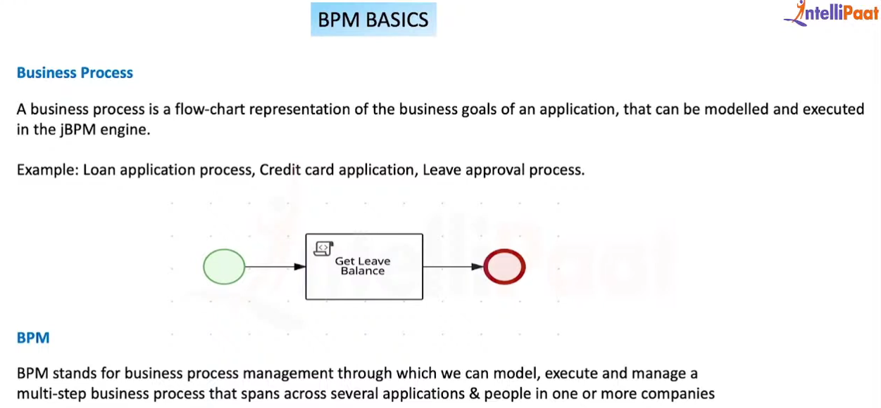


Slide 3
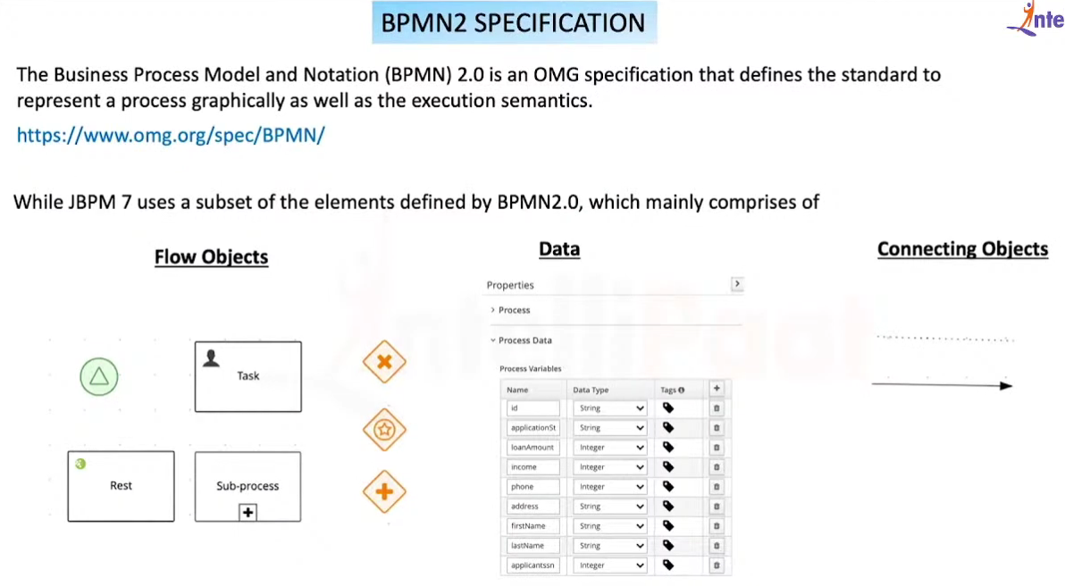



Slide 4
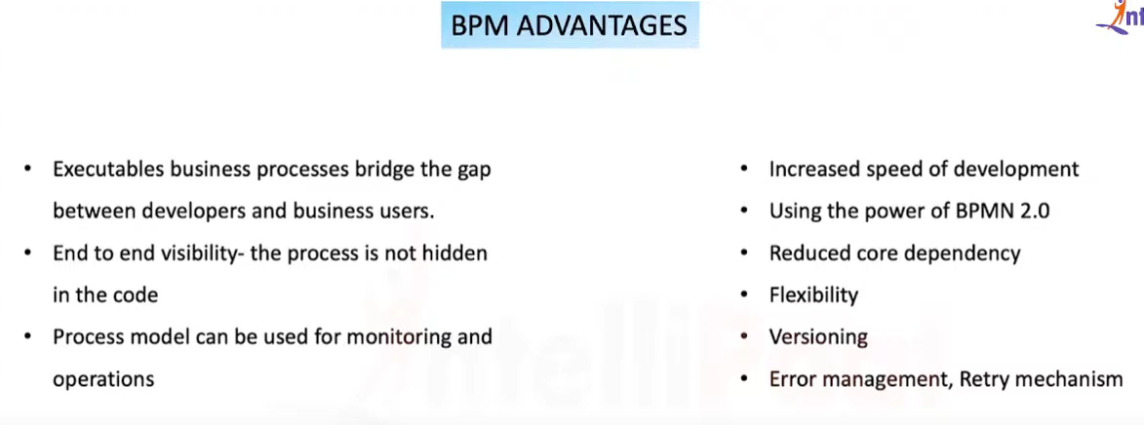



Slide 5
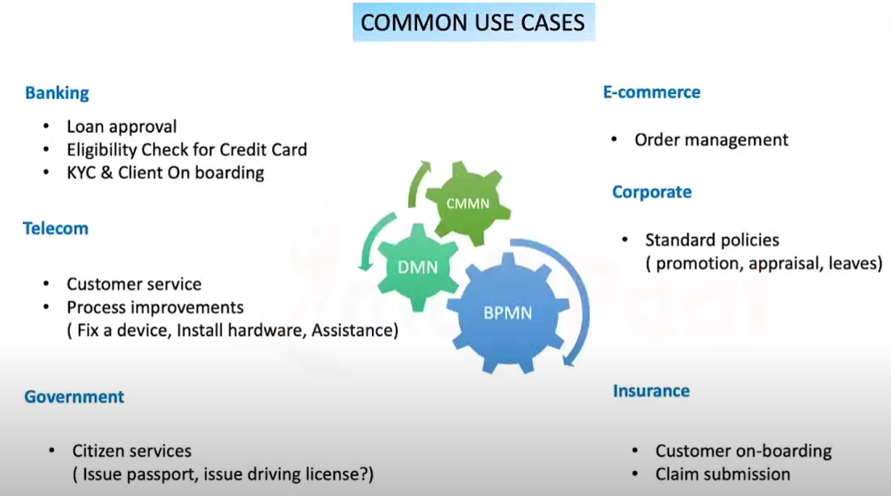


Slide 6
Most Popular BPMs
JBPM ( RedHat ) ( Open source ), ( from 7.X onwards community version & enterprise versions available )
Camunda ( Camunda Services GmbH )
Flowable (Flowable Inc. )

Slide 7
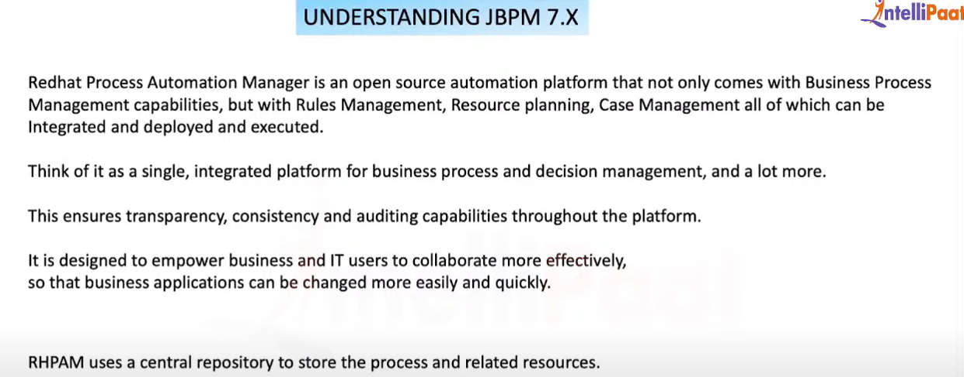


Slide 8
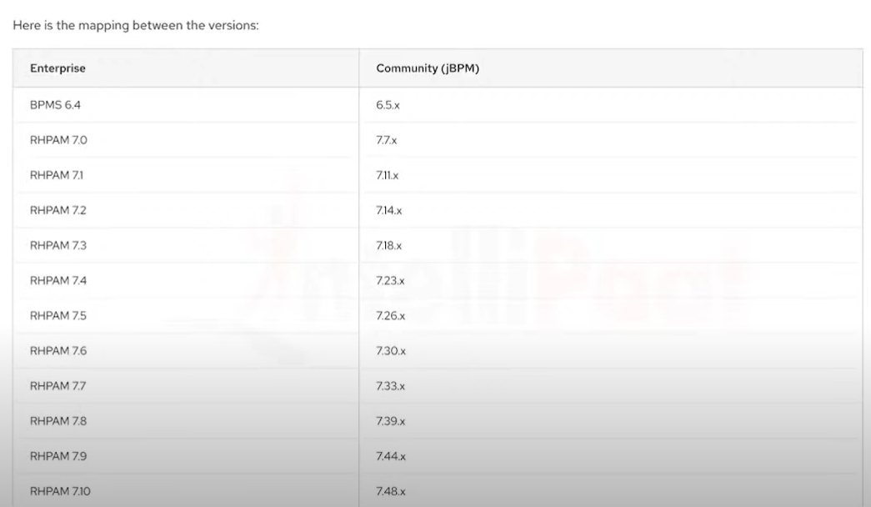


Slide 9
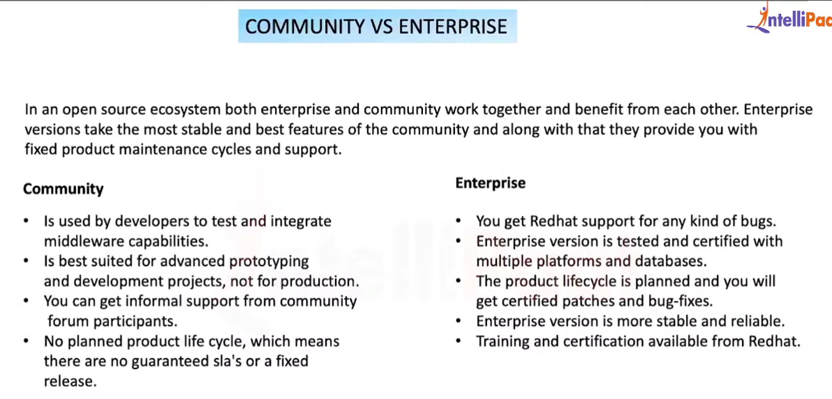


Slide 10
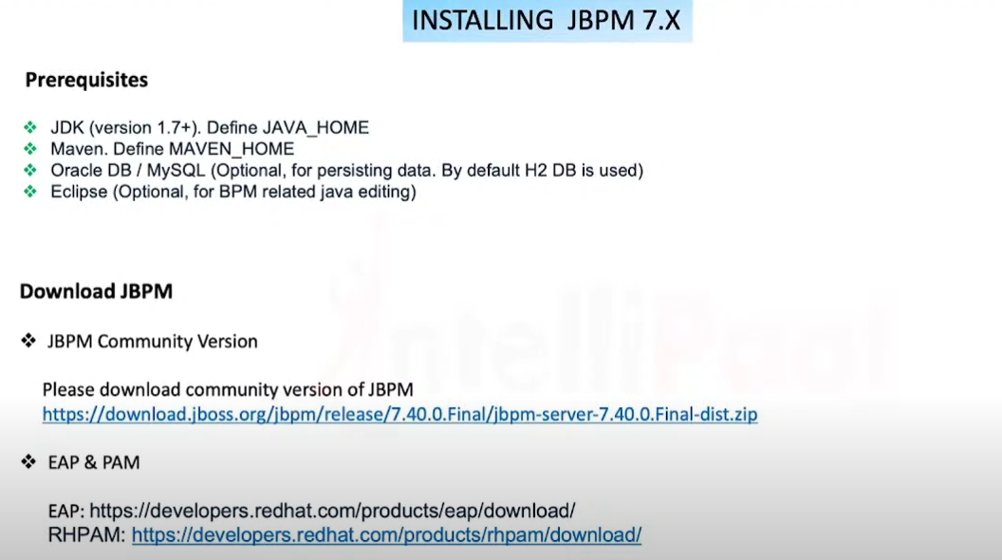


Slide 11
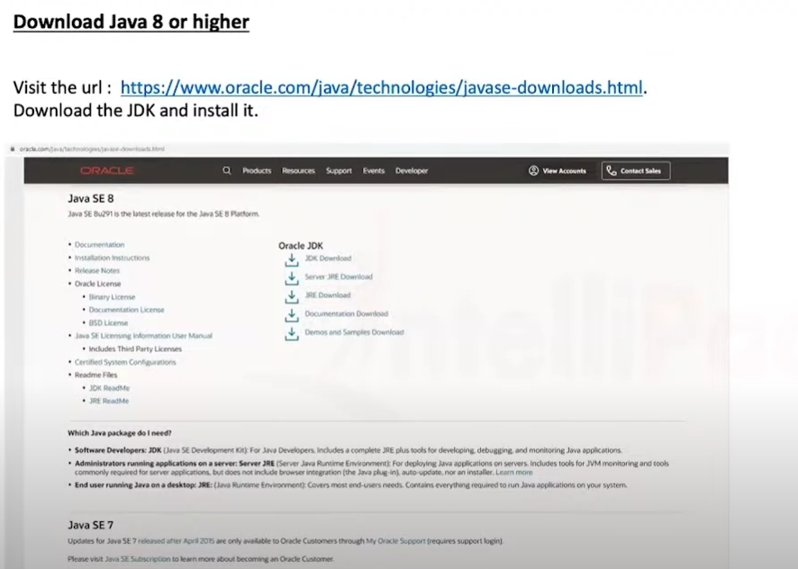

Slide 12
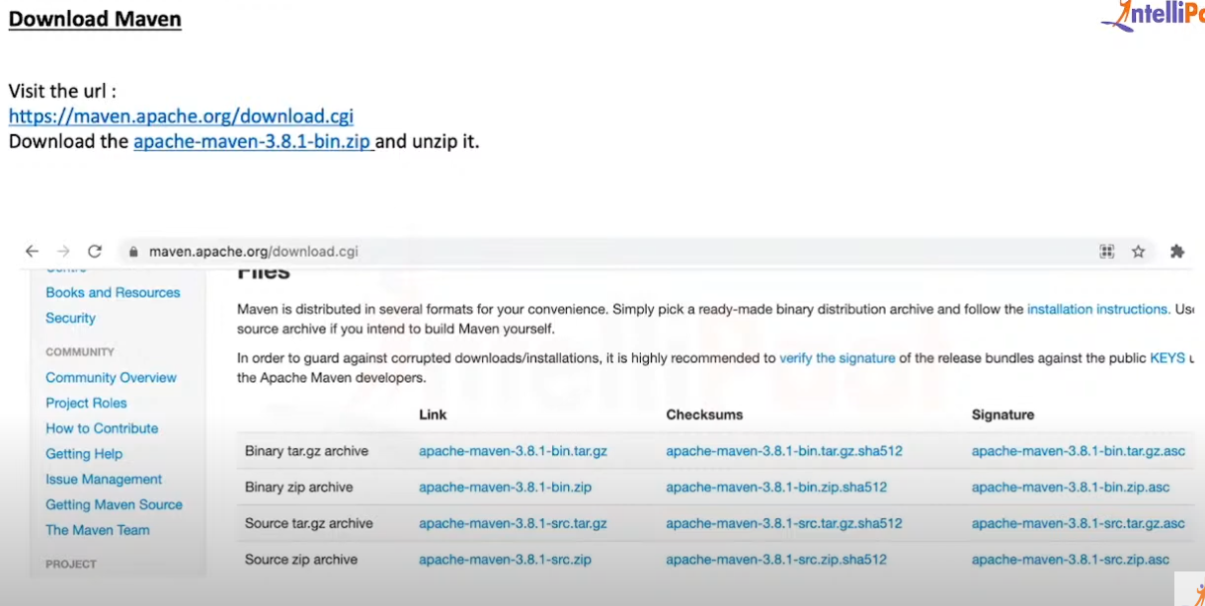


Slide 13
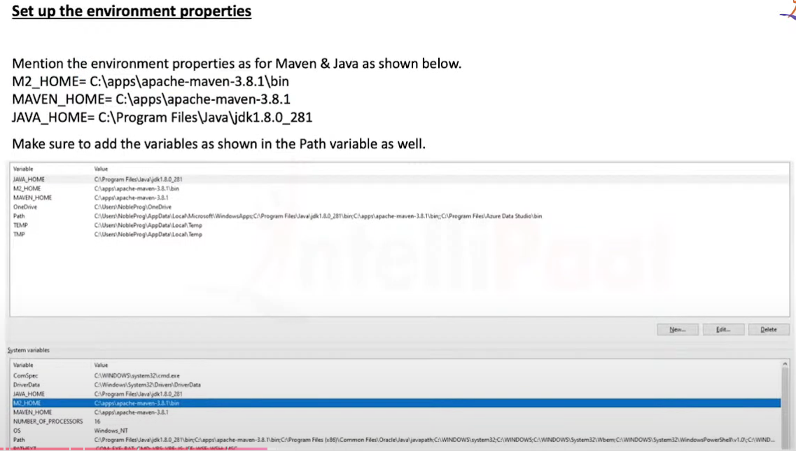



Slide 14
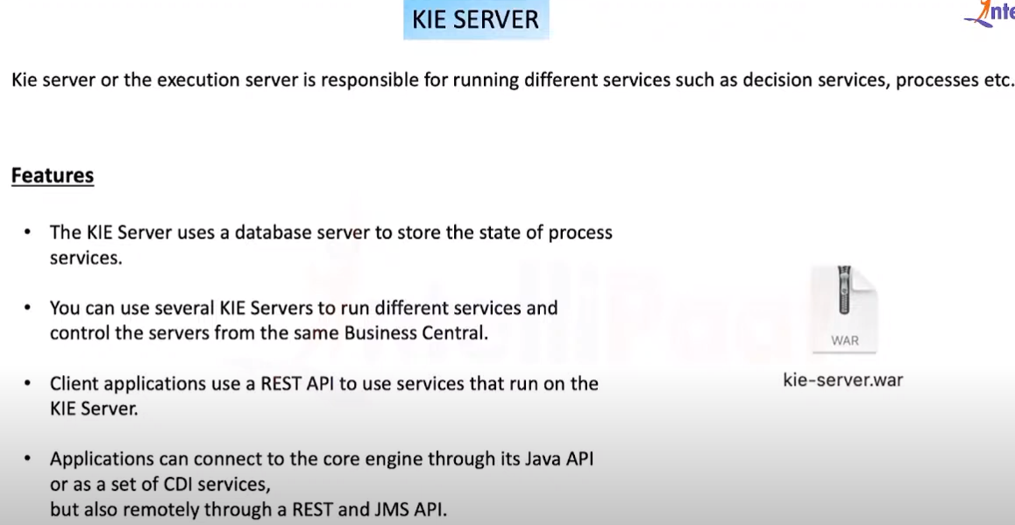



Slide 15
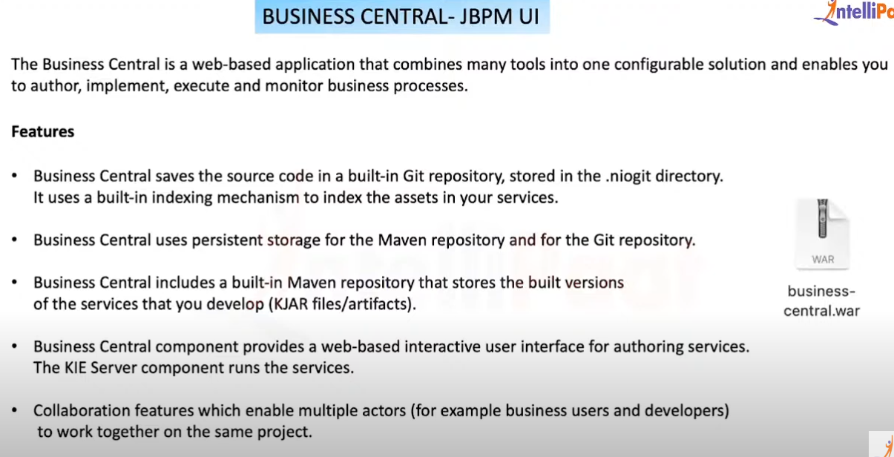





Slide 16
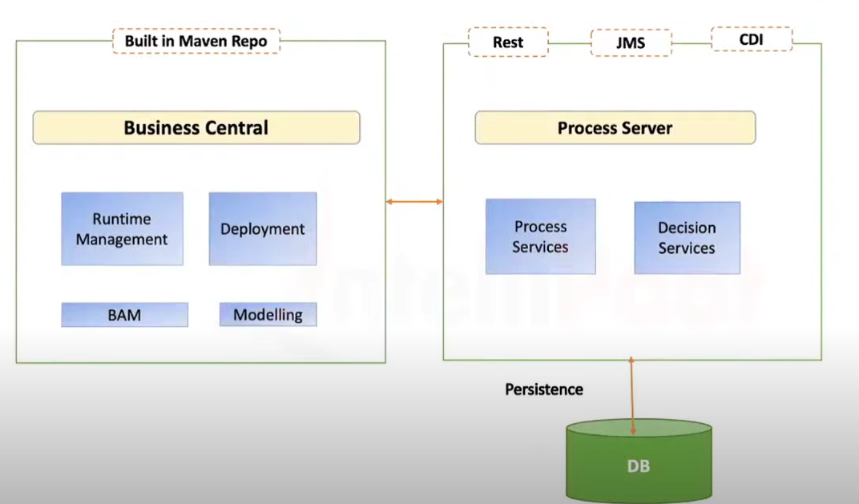




Slide 17
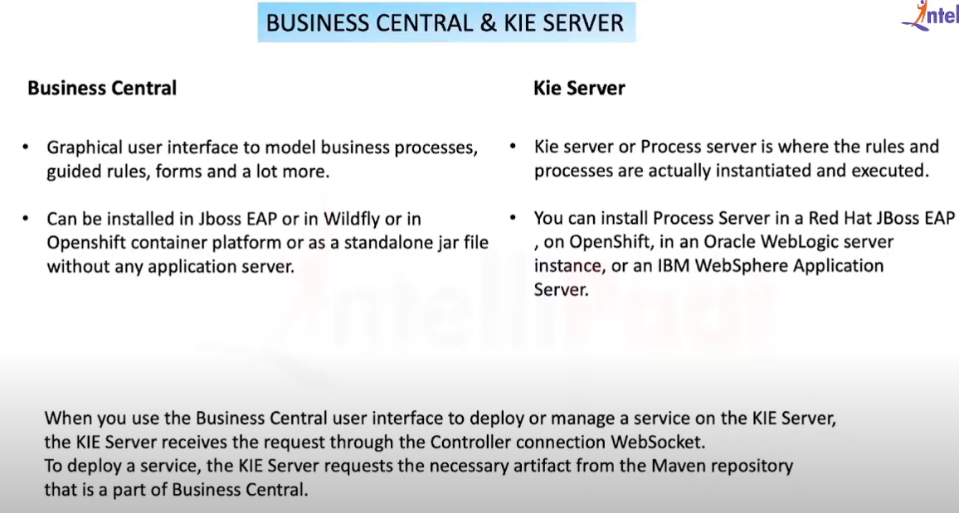


Slide 18
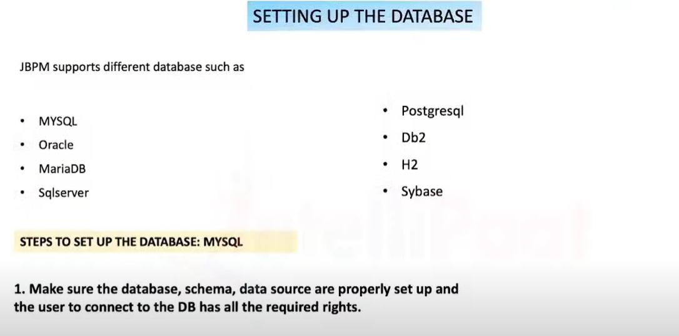


Slide 19
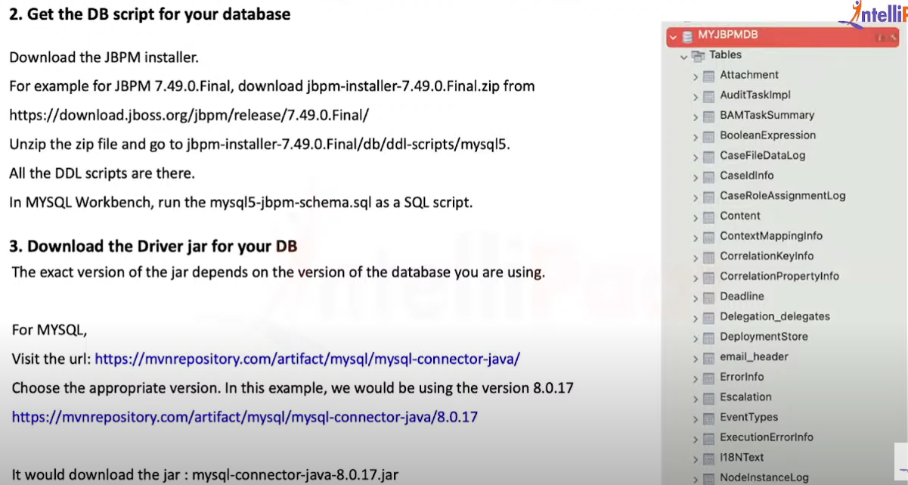

Slide 20
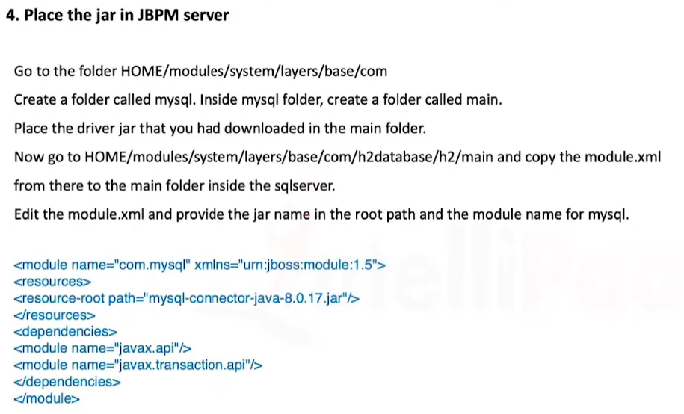

Slide 21
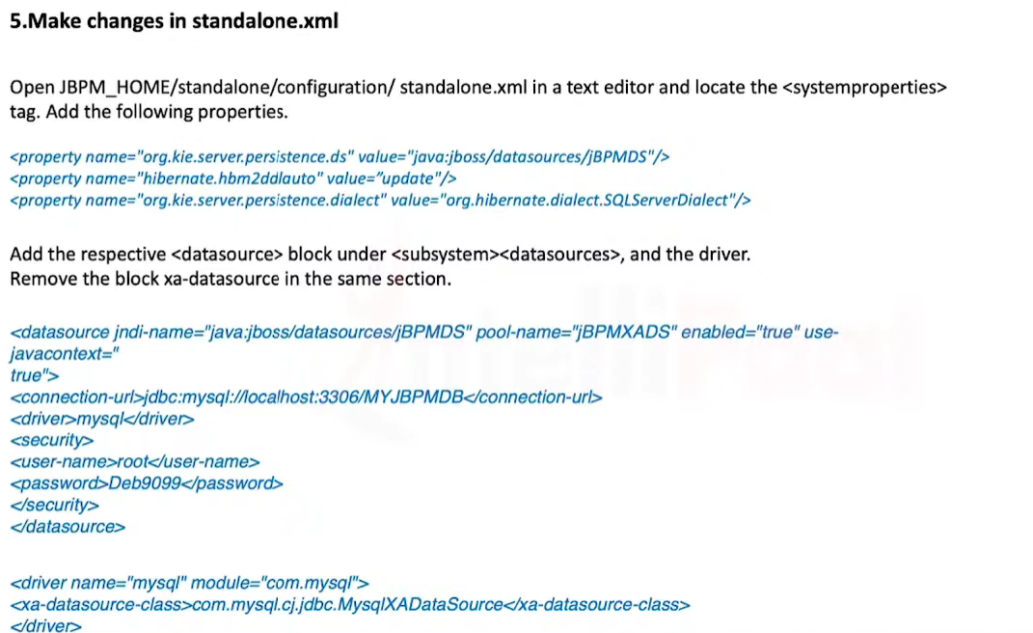

Slide 22
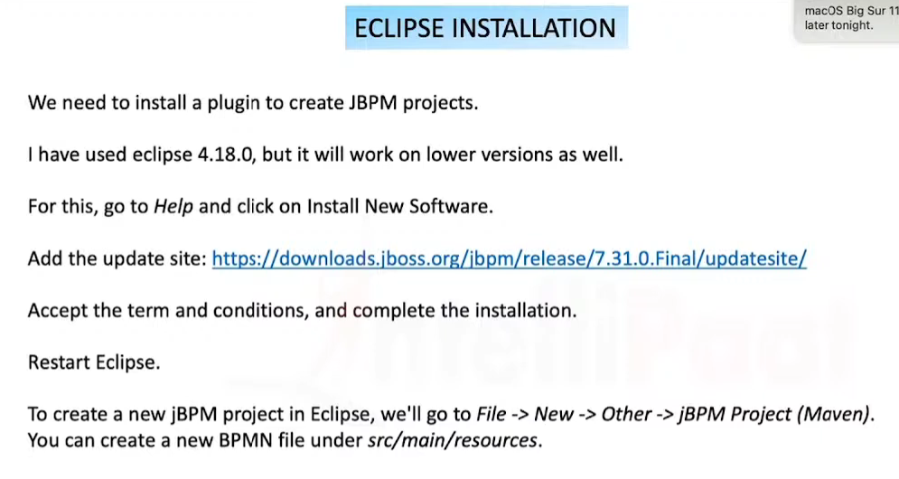


Slide 23
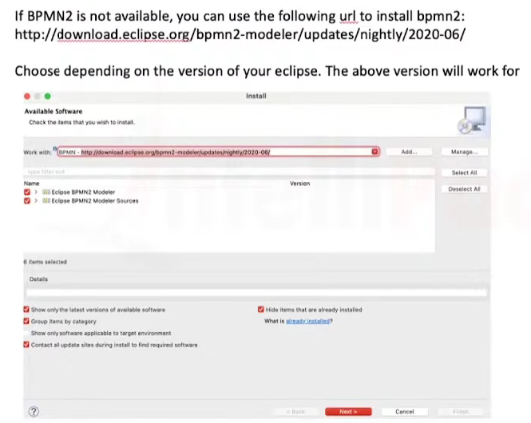


Slide 24
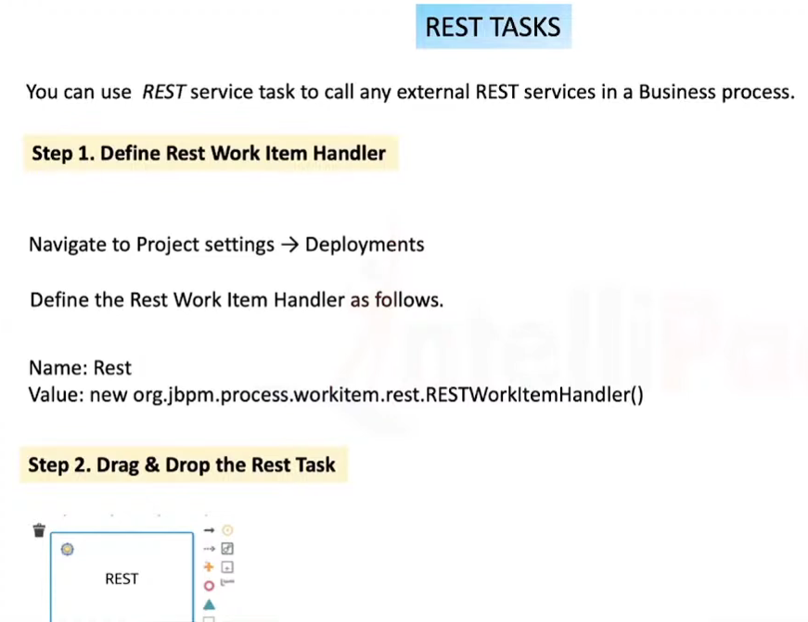

Slide 25
Logging in to Business Central
http://localhost:8080/business-central/
Username : wbadmin
Password : wbadmin
https://docs.jbpm.org/7.74.1.Final/jbpm-docs/html_single/#JBPMExamples

Slide 26
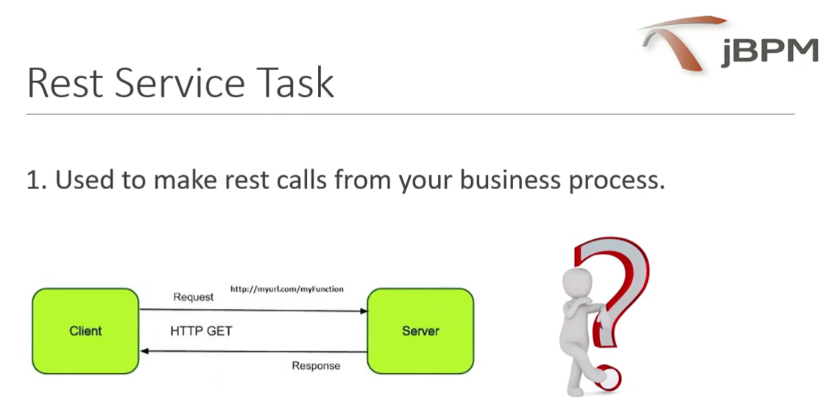

Slide 27
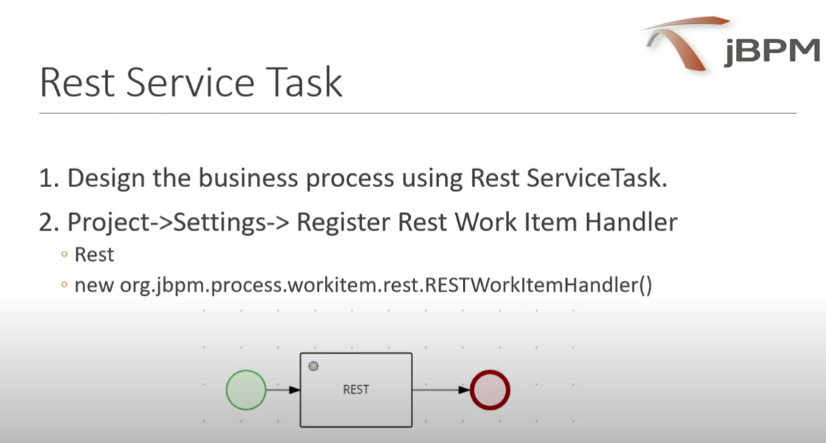

Slide 28
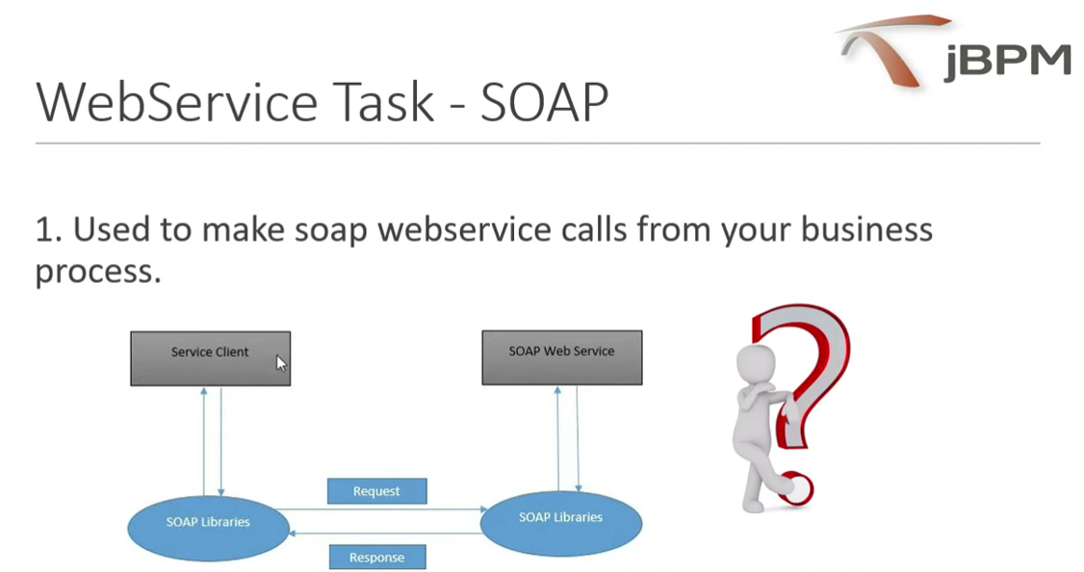

Slide 29
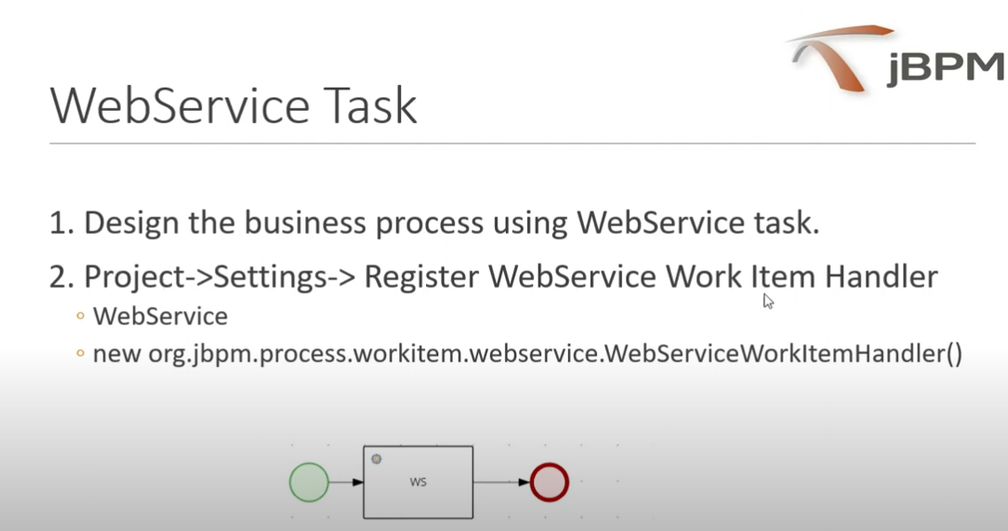

Slide 30
* Create react project : npx create-react-app <app-name>
* Add bootstrap : npm install --save bootstrap
* Start react app standalone : npm start
* Curl : curl -i -H "Accept: application/json" <URL>

Slide 31
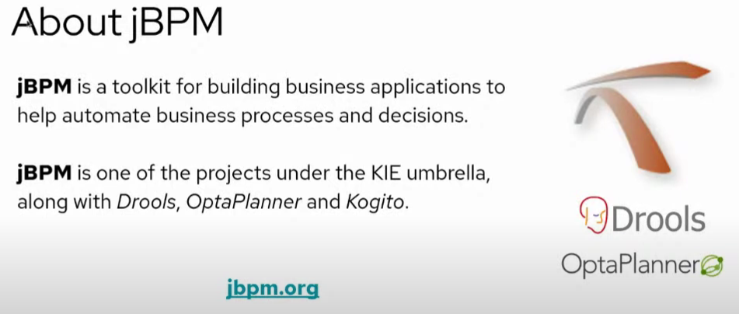

Slide 32
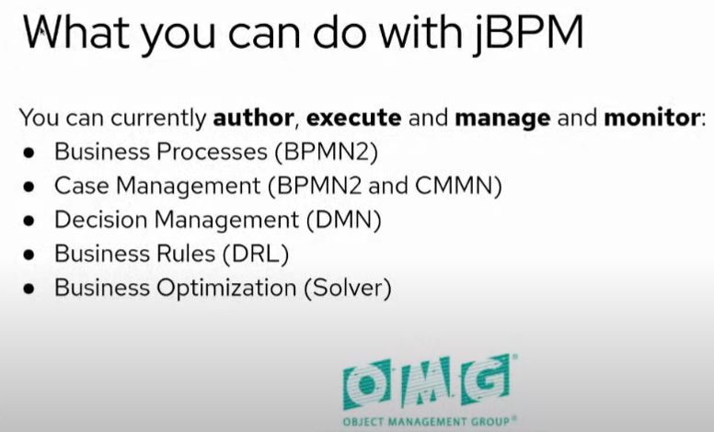

Slide 33
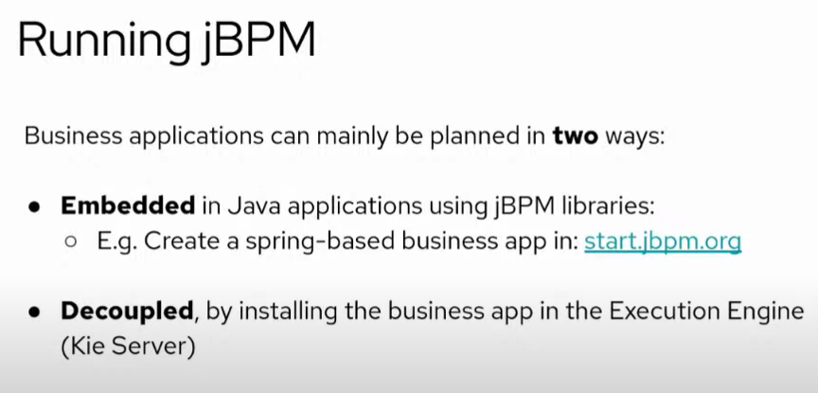

Slide 34
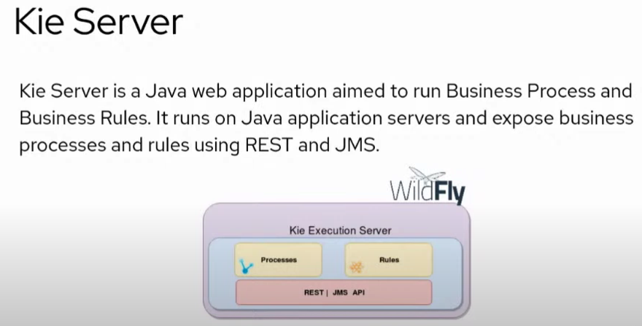

Slide 35
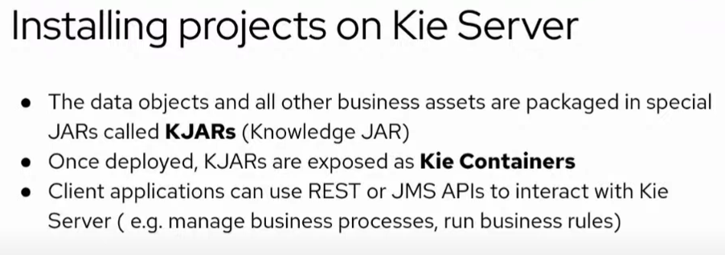

Slide 36
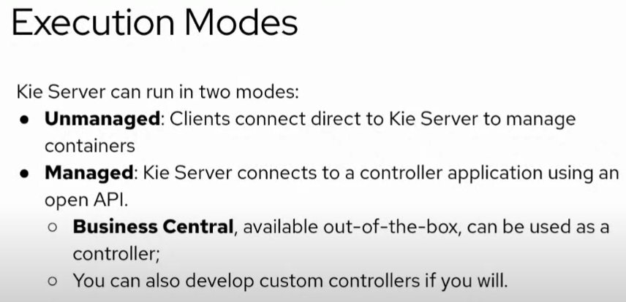

Slide 37
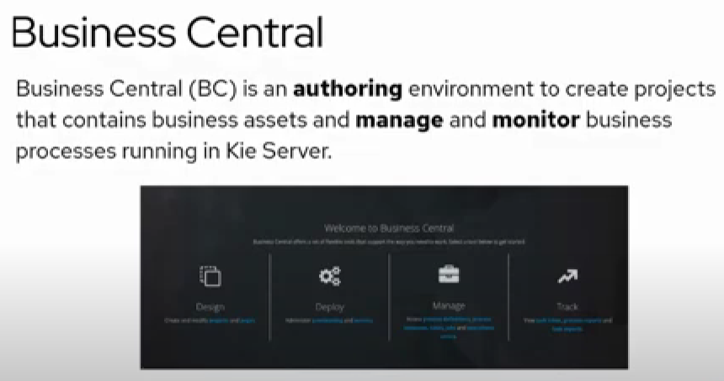

Slide 38
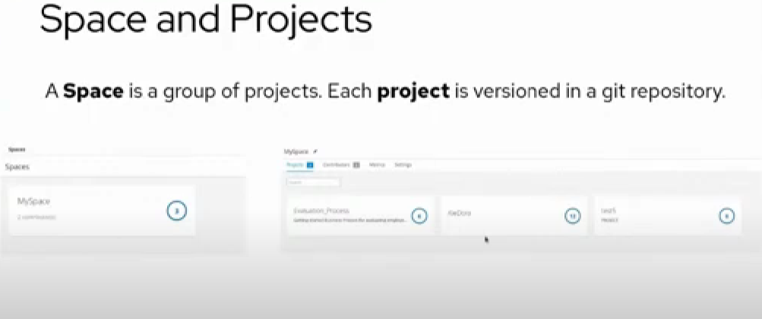

Slide 39
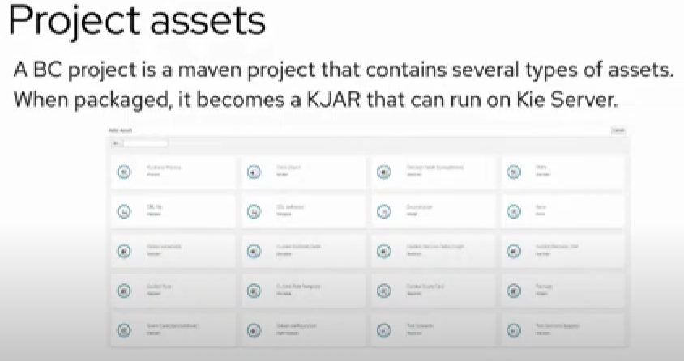

Slide 40
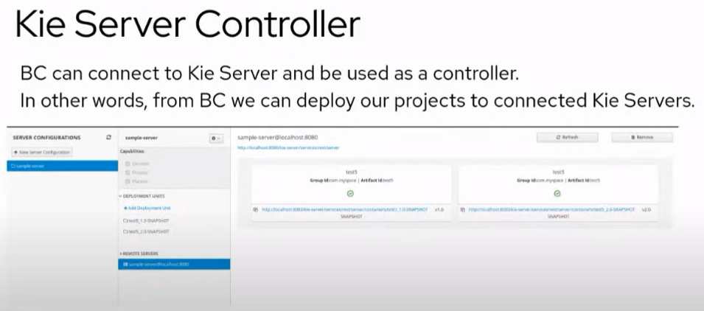

Slide 41
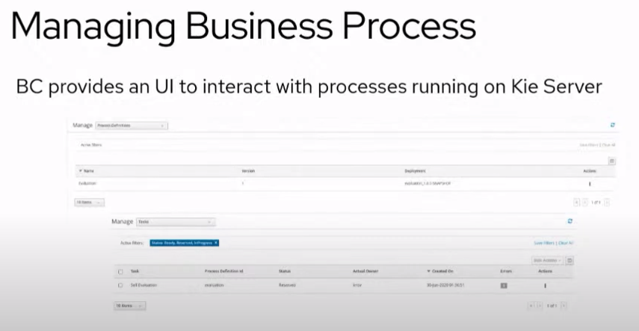

Slide 42
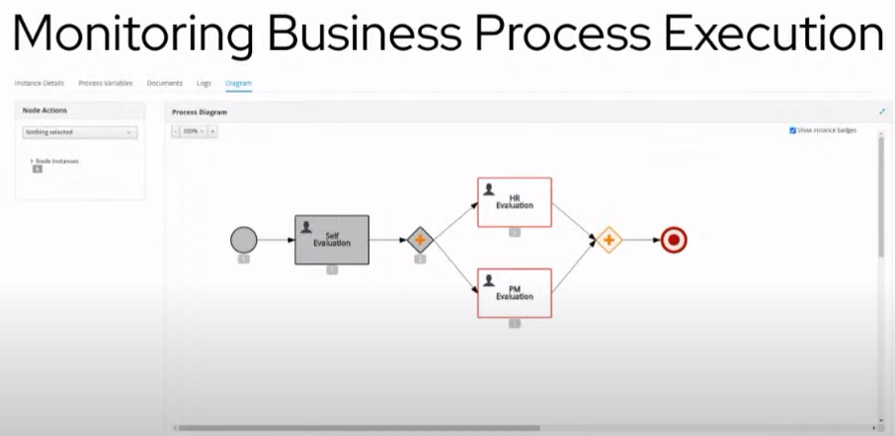

Slide 43
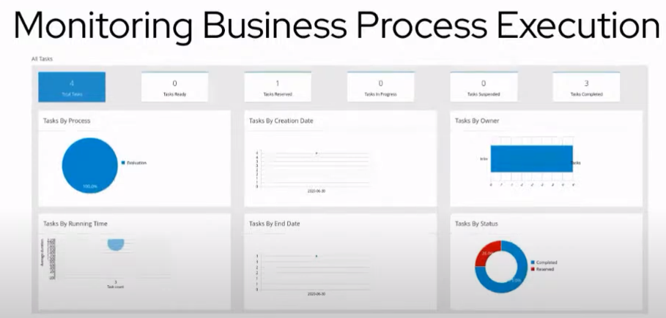

Slide 44
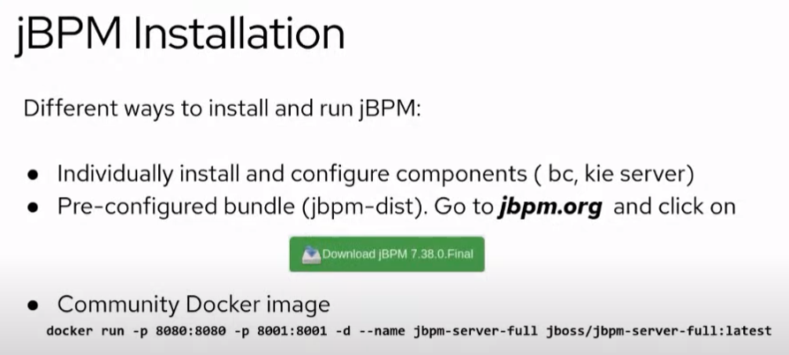

Slide 45
